Slide 1



Call Center Customer Satisfaction Data by Kamal Kumar
View in Power BI
Last data refresh:
11/9/2021 6:01:18 AM UTC
Downloaded at:
1/17/2022 12:12:50 PM UTC

Slide 2
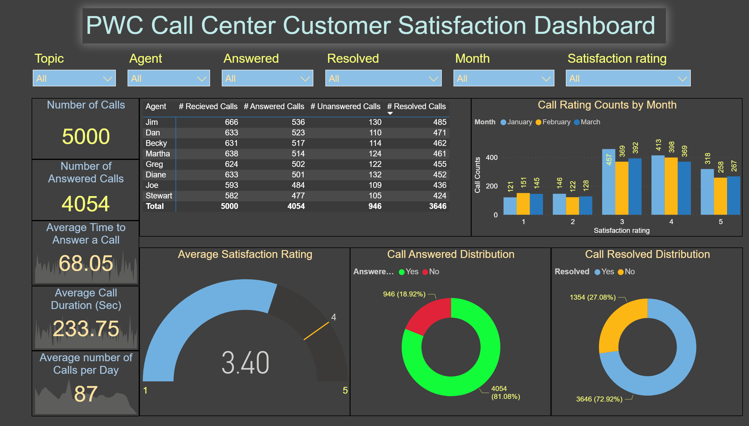
Page 1
Notes:
textbox
No alt text provided
slicer
No alt text provided
slicer
No alt text provided
slicer
No alt text provided
slicer
No alt text provided
Average Satisfaction Rating
No alt text provided
Distribution of Calls by Agent
No alt text provided
Call Rating Counts by Month
No alt text provided
Call Answered Distribution
No alt text provided
Call Resolved Distribution
No alt text provided
Average Time to Answer a Call
No alt text provided
Average number of Calls per Day
No alt text provided
Average Call Duration (Sec)
No alt text provided
Number of Calls
No alt text provided
Number of Answered Calls
No alt text provided
slicer
No alt text provided
slicer
No alt text provided

